Slide 1

Microservice : 3PL Billing Module
Micro-Casper : Hackathon 2020

Slide 2
Agenda
Overview
Objective
Design
Demo
Next Steps
Team Members
Questions

Slide 3
Objective
Replacing Sterling WMS ARE module with a NoSQL based Microservice.
Notes:
Sales organizations can be defined based on the following characteristics:
Sales channel - for example, wholesale, retail or direct sale.
Product Line - for example, electronics, entertainment, and service.
Geography - the geography of the ship-to location of orders. For
example, east-coast or west-coast.
Customer - (major customers).
A combination of one or more of the above.
Purchasing organizations could be created centrally or can be associated with each legal entity or sales organization. Purchasing organizations can also be
modeled based on product lines, geography, or vendors.

Slide 4



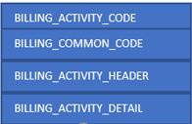
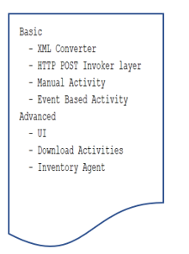
Architecture Diagram
Billing Microservice
Sterling WMS
Microservice subnet
Microservice subnet
Billing Microservice
6/3/2020
© 2020 Bridge Solutions Group, Proprietary And Confidential. Visit us at www.bridgesgi.com for more information
Notes:
Sales organizations can be defined based on the following characteristics:
Sales channel - for example, wholesale, retail or direct sale.
Product Line - for example, electronics, entertainment, and service.
Geography - the geography of the ship-to location of orders. For
example, east-coast or west-coast.
Customer - (major customers).
A combination of one or more of the above.
Purchasing organizations could be created centrally or can be associated with each legal entity or sales organization. Purchasing organizations can also be
modeled based on product lines, geography, or vendors.

Slide 5

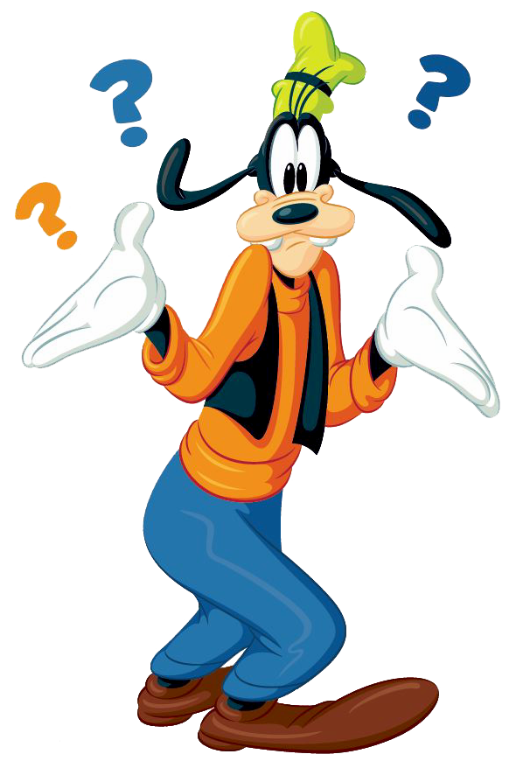
Spring Boot Microservice
Business layer
Entity Layer
What logic to use
Cannot see through

Slide 6
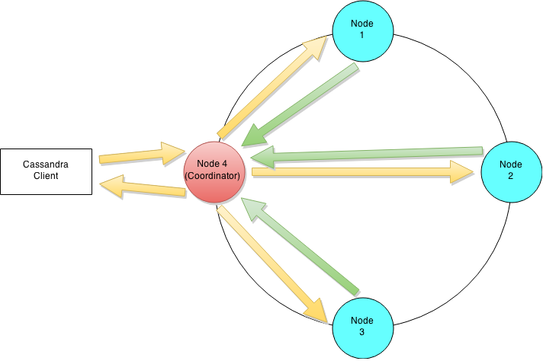
Why NoSQL ??
NoSQL Databases can handle huge amount of data and are easily scalable.
Data Layer – Cassandra
High availability with multiple nodes
Fault -Tolerant
Scalability
Multi Data Centres

Slide 7
Tech Stack
Sterling WMS 9.5
Spring Boot 2.2.5
Cassandra 3.11.6
Docker 1.8.0

Slide 8
DEMO
Use Case
Record billing activities in external database
View the recorded activities in sterling console

Slide 9

Future Steps
Enhance the current application's Entity layer to support dynamic class generation.
Derive the UX layer (React-Redux) as the separate micro-service to support the Billing Recording life-cycle.
POC on locking mechanism to support inventory dependent module decomposition (Picking, Packing, Count, etc.).
Make it support on cloud-based technology (Kubernetes)

Slide 10
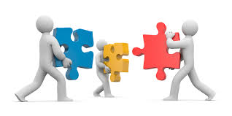
Team Members
Abhishek Verma
Afreen Khanum
Ezhilarasan V
Keerthi Yadav
Manoj G
Nagarjun T
Srinivas B

Slide 11
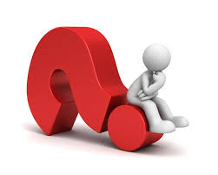

Slide 12

Thank You

